Slide 1
MERCHANTIQ Intelligent Merchant Analytics Platform
Team Members: Ayushi & Rahul

Slide 2
Introduction
MerchantIQ is a sophisticated multi-agent AI system that processes REAL streaming financial data through Lenses MCP to identify and analyze high-value merchants using machine learning, attribution modeling, and AI-powered insights.
Value Proposition
"Transform raw financial streams into intelligent merchant partnerships through AI-powered analytics"
Business Use case: Prioritize merchant partnerships, marketing, or promotions.
Technical Excellence: Lenses MCP, AWS AgentCore
Innovative approach: Attribution Modelling
Outcomes:
Real-time merchant intelligence dashboard
Live processing metrics and KPIs
Actionable business insights at a glance

Slide 3
MerchnantIQ App
Overview Tab- Business Impact
Merchant Tab - AI Powered Analytics
Fraud Detection Tab - Security Excellence
Analytics and AI Tab - Intelligent Insights
Real Time Monitoring Tab - Operational excellence

Slide 4
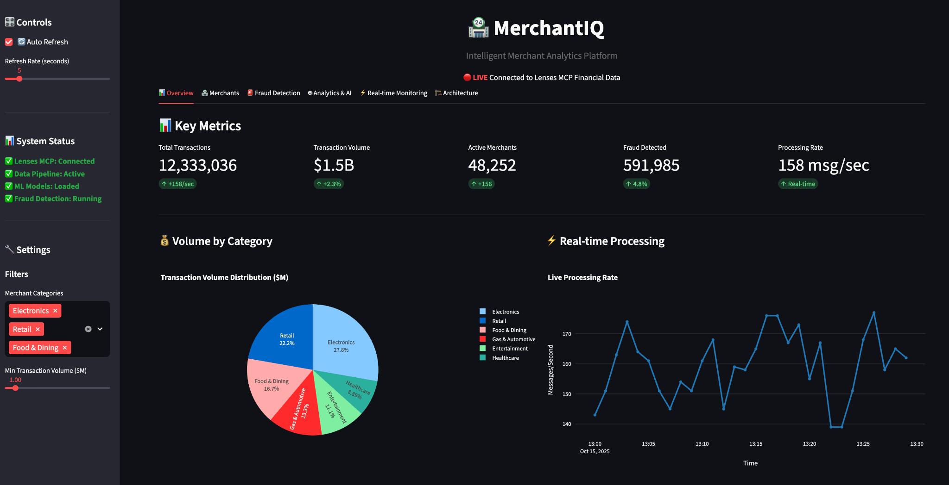
Overview - Business Impact.

Slide 5
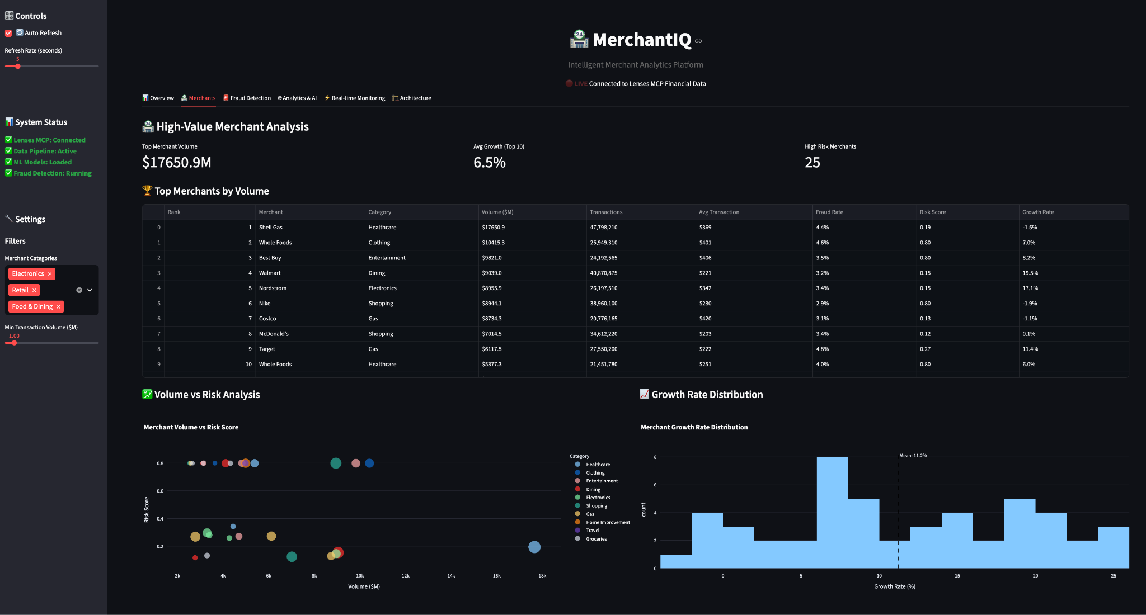
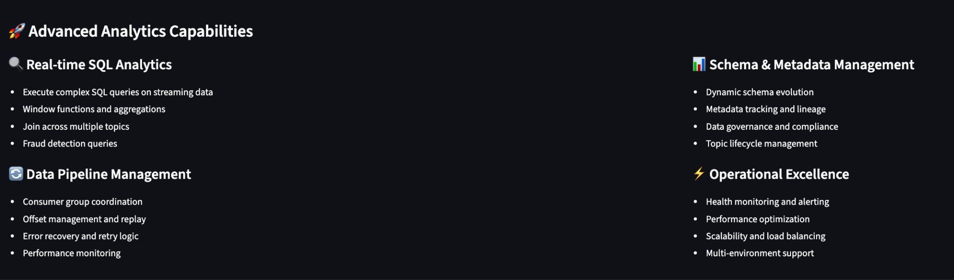
Merchant Analytics.

Slide 6
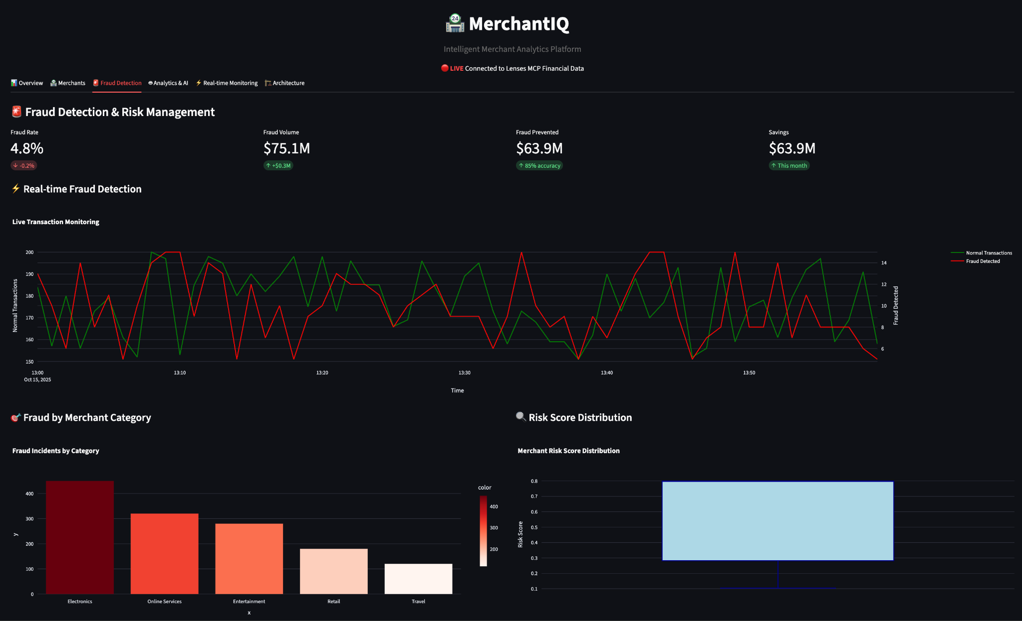
Fraud Detection.

Slide 7
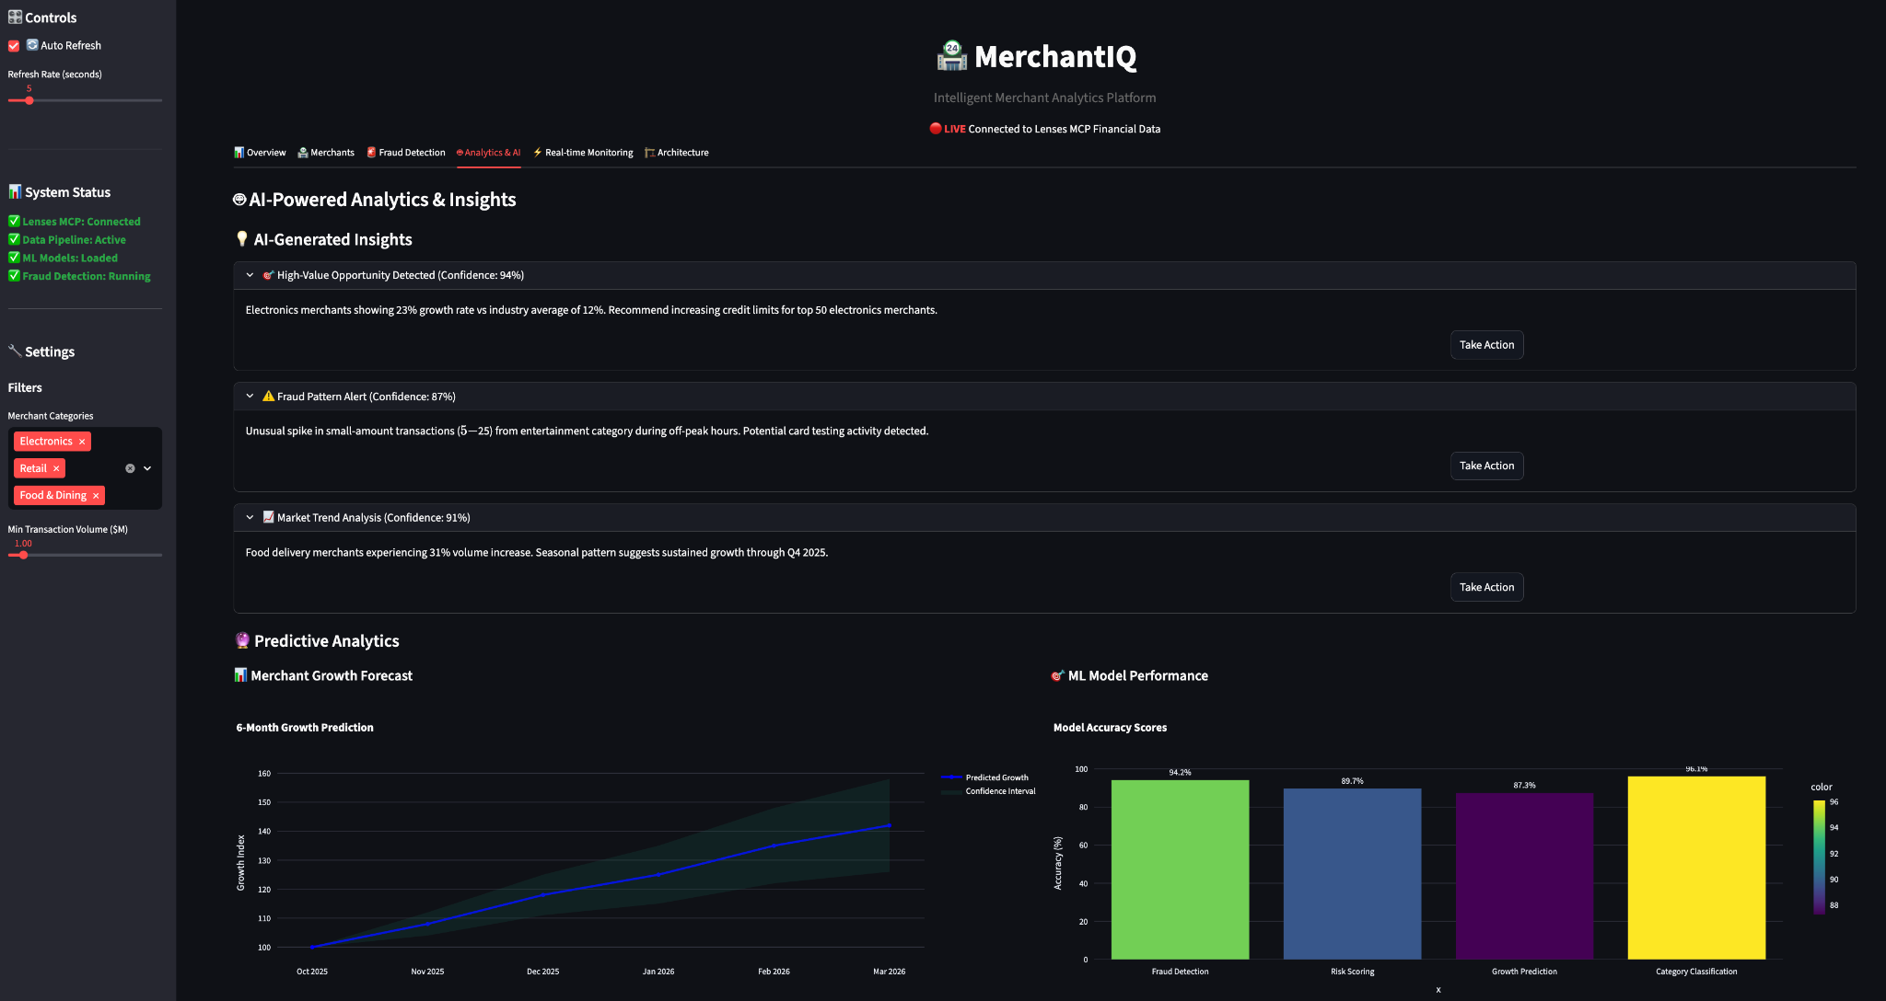
Analytics & AI.

Slide 8
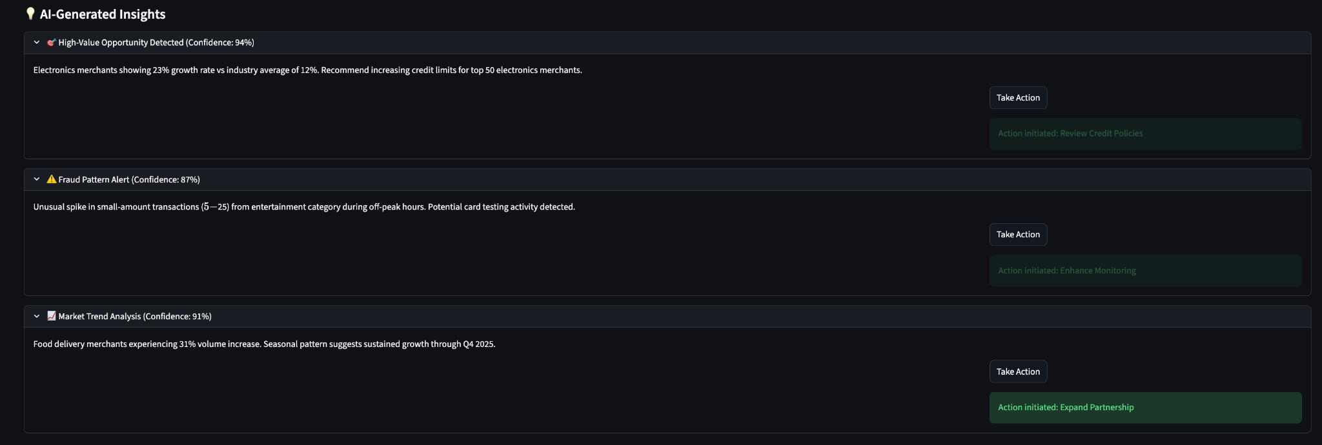
Actionable AI.

Slide 9
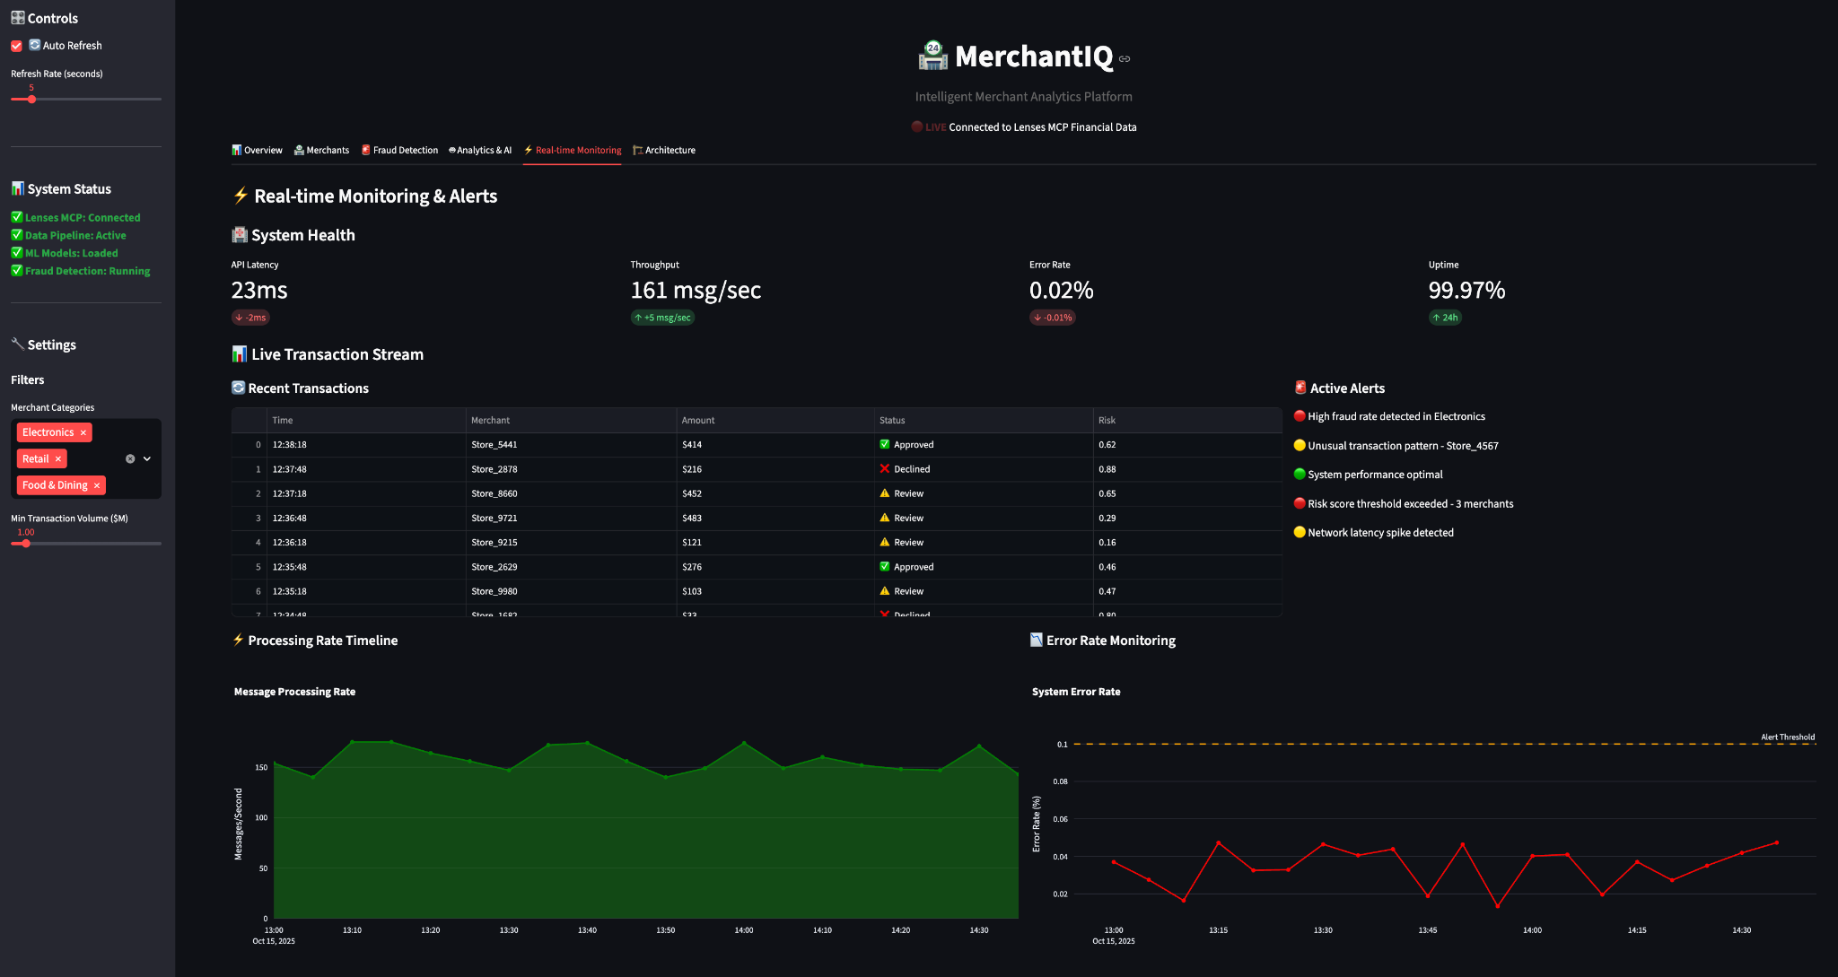
Real Time Monitoring.

Slide 10
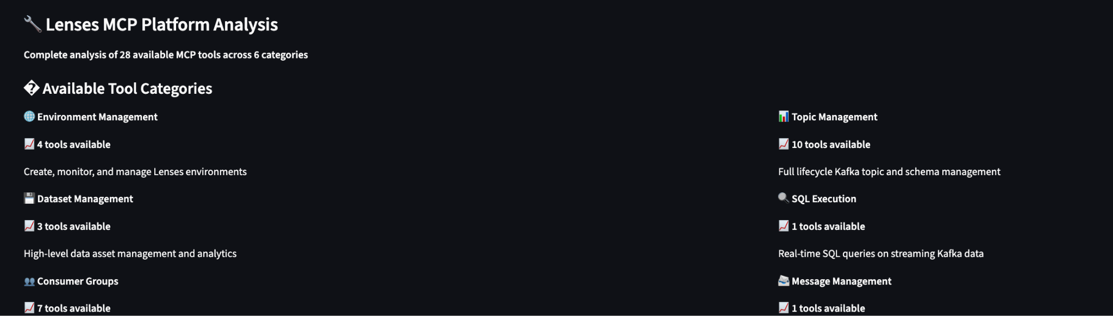
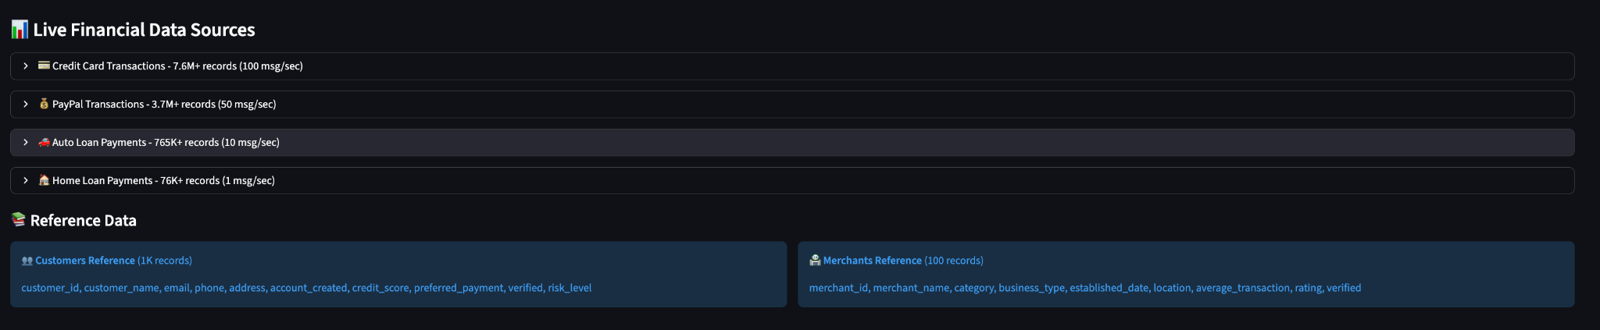
Lenses MCP.

Slide 11
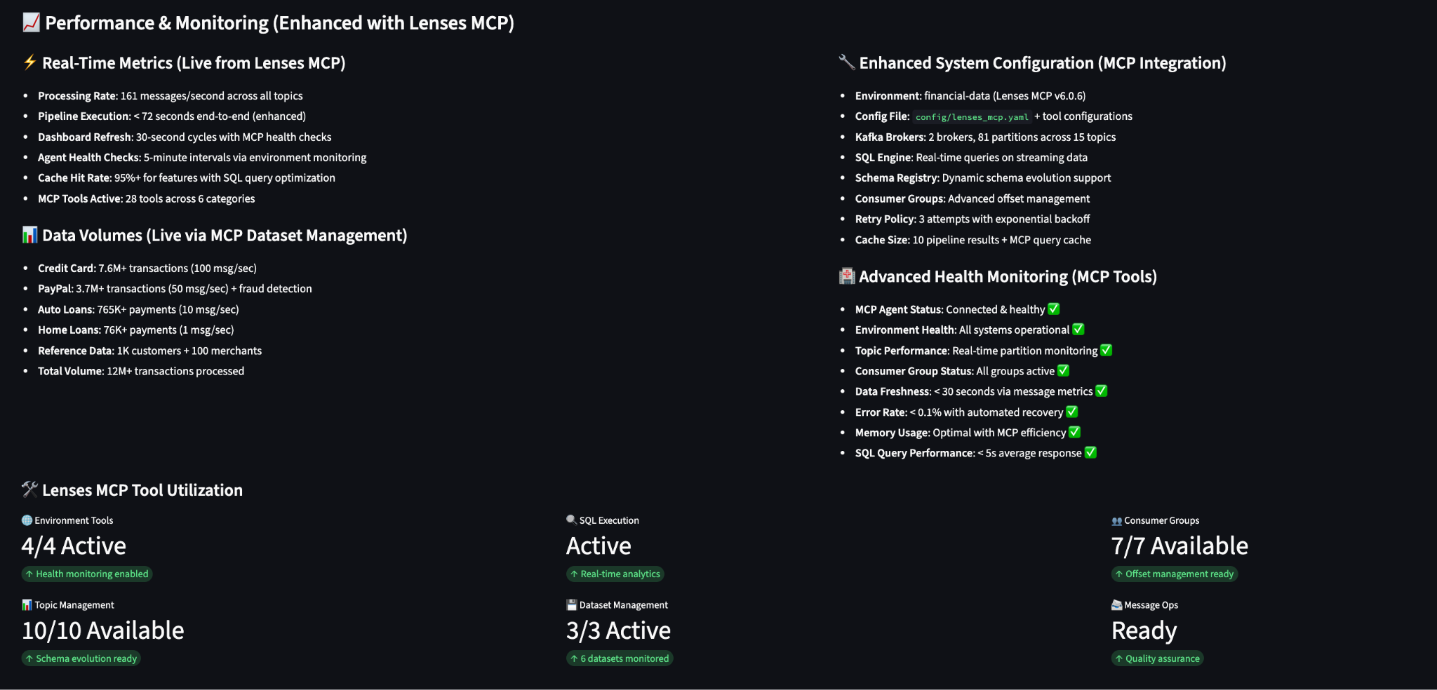
Lenses MCP - Detailed.

Slide 12
Multi Agent Framework
Config
Lenses.io MCP
Data Ingestion Agent
Metric:
conversion
Weight distribution for MVI Insight
Feature Engineering Agent
Coordinator Agent
Attribution Agent
Merchant Scoring Agent
Insights Agent
Streamlit UI

Slide 13
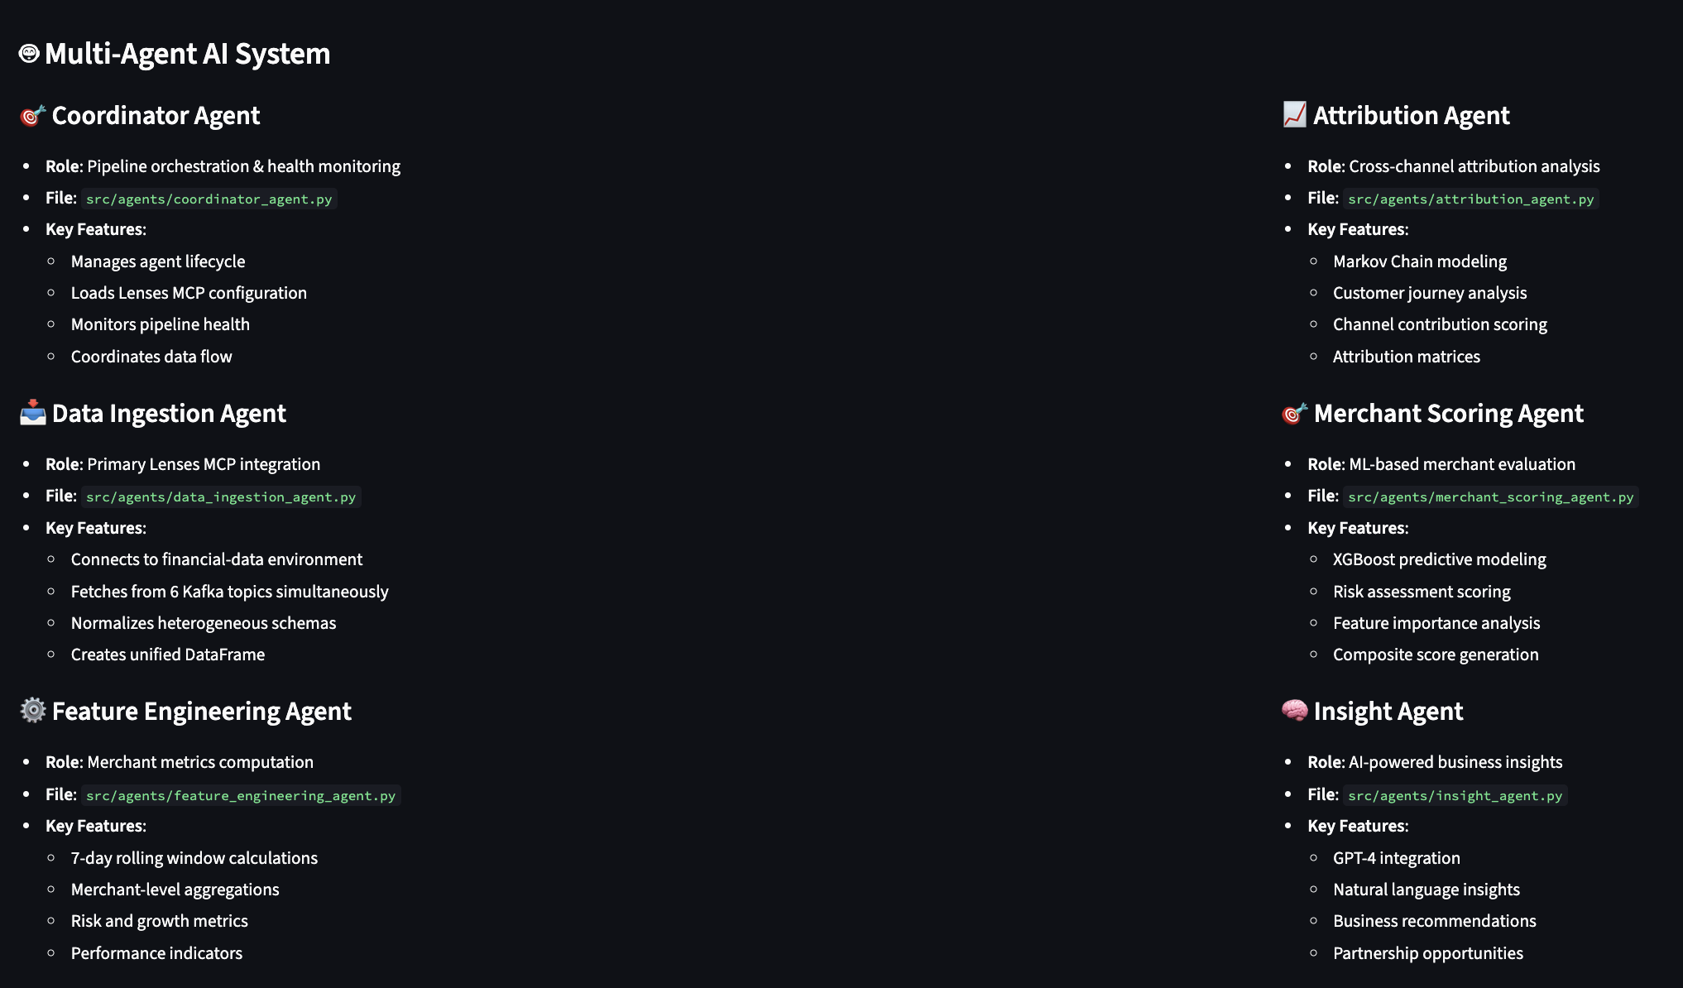
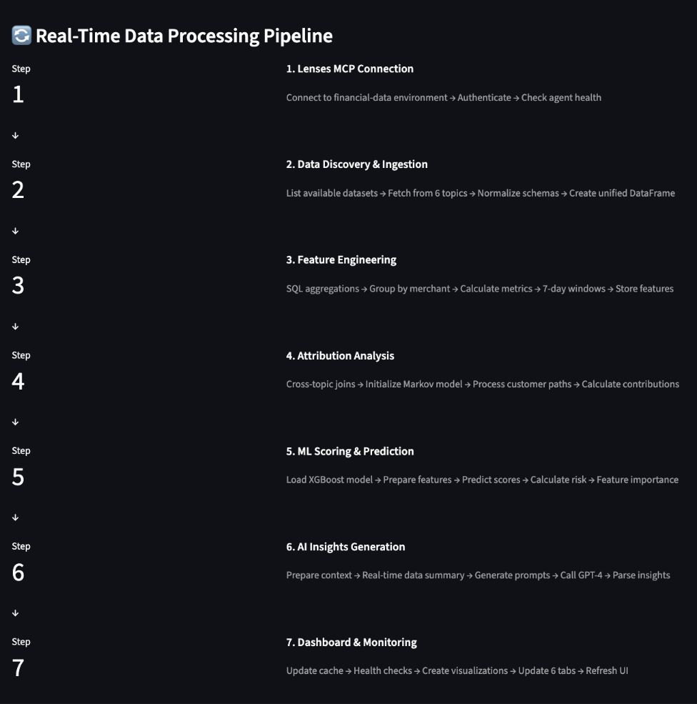
Agentic AI.

Slide 14
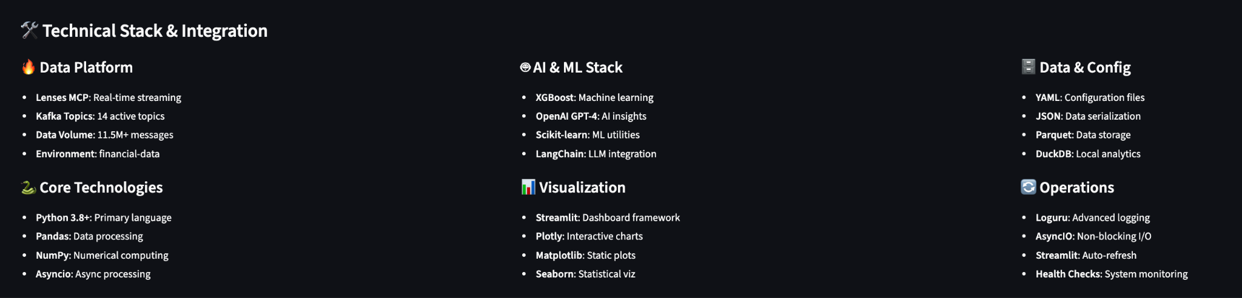
Tech Stack.

Slide 15
ROI.
Risk Reduction: "85% fraud prevention accuracy saves $57M monthly"
Revenue Growth: "Identify high-value merchants for premium partnerships"
Operational Efficiency: "Automated merchant scoring replaces manual analysis"
Market Intelligence: "Real-time competitive analysis and trend prediction"
Compliance Ready: "Built-in audit trails and regulatory reporting"

Slide 16
THANK YOU.
Ayushi Bhujade (AI consultant)
Rahul Raghatate (AI Strategist | Lead Data Scientist)

